Slide 1
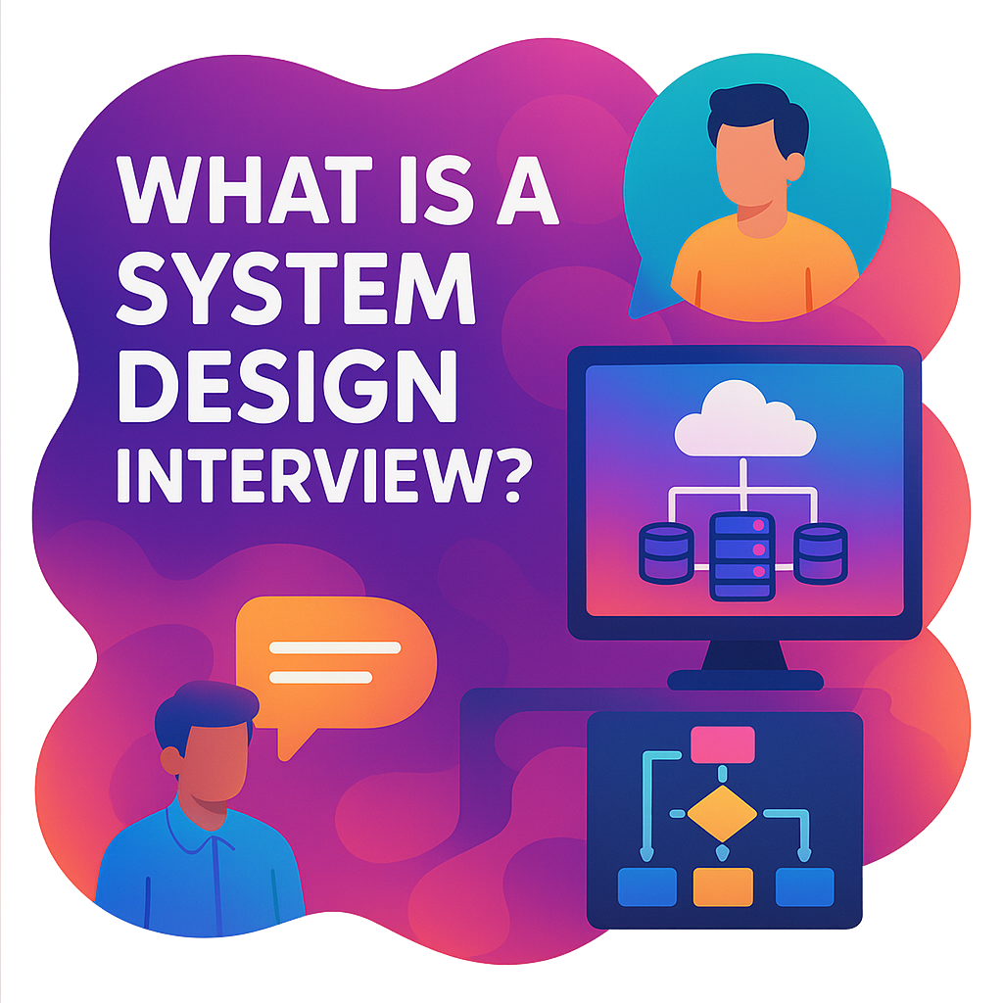
What is a System Design Interview ?
A System Design Interview is a technical discussion used by companies especially big tech and product companies to evaluate your ability to design scalable, reliable, and maintainable software systems.
Why Companies Ask This:
Because building real-world systems requires:
Balancing trade-offs
Thinking beyond code (latency, storage, security, etc.)
Collaborating across teams
Who Typically Gets These Interviews:
Backend engineers
Full-stack developers
SDE-2 or higher
Engineering managers
DevOps/SREs (with focus on reliability)

Slide 2
BEFORE THE INTERVIEW (Preparation Phase)
Master the Fundamentals
Understand system design building blocks: load balancers, databases (SQL/NoSQL), caches, queues, proxies, etc.
Be clear about CAP theorem, latency vs throughput, horizontal vs vertical scaling, etc.
Be ready to explain when to use each tool or technique, not just what they are.
Have a Framework
Use a structured approach like the FAANG 7-step framework:
Clarify requirements
Define APIs
High-level architecture
Component design
Database schema
Scalability & bottlenecks
Trade-offs & improvements
Practice Common HLD Problems
Prepare to design systems like:
URL Shortener (TinyURL)
Rate Limiter
Messaging System (WhatsApp, Slack)
Ride Hailing (Uber)
Video Streaming (YouTube, Netflix)
Newsfeed (Facebook, Twitter)
File Storage (Dropbox, Google Drive)
E-commerce Platform
Design a ATM/Vending Machine
Design Content Delivery Network (CDN)
Design Parking Garage

Slide 3
DURING THE INTERVIEW (Execution Phase)
1. Clarify Requirements Upfront
Functional requirements (e.g., upload video, stream video)
Non-functional (e.g., latency, availability, consistency, scale)
Constraints (e.g., expected QPS, file size)
Don’t start drawing boxes before you know what the system needs to do!
2. Think Loud & Structure Your Thought Process
Explain your decisions clearly. Structure your answer as:
Client interactions → API Gateway → Services → Storage → Caching → Async processing
3. Draw and Explain High-Level Architecture
Use components like load balancer, web server, application layer, DB, CDN, etc.
Explain data flow: how requests move through the system.
4. Talk About Trade-Offs
E.g., SQL vs NoSQL, consistency vs availability, monolith vs microservices. Show you understand real-world engineering constraints.
5. Cover Scalability and Reliability
Use of caching (Redis/Memcached) for performance
Sharding/Partitioning for DB scalability
Replication for availability
Load balancers, CDNs, queues (Kafka/SQS) for throughput
6. Discuss Bottlenecks and Failure Scenarios
What happens when the DB goes down?
How would you handle a sudden spike in traffic?
Where is the single point of failure?
7. Summarize at the End
Recap: The components you designed -> The flow of data -> How it meets the requirements -> Future improvements (like machine learning, analytics, etc.)
Interview Soft Skills
Be collaborative: Ask questions and engage with the interviewer.
Don’t jump to scaling too soon: Start simple, then evolve.
Admit if you don’t know something show how you’d find a solution instead.

